Slide 1

Network Topologies and Simulations Using GNS3
An In-Depth Analysis
Muhammad Ammar Hashmi
01-134201-048

Slide 2
What is GNS3?
Network simulation tool.
Emulates real network devices and configurations.
Provides a virtual environment for testing and learning.

Slide 3
Why Use GNS3?
Cost-effective: No need for physical hardware.
Safe environment: Test configurations without risk.
Flexible: Supports various network topologies and devices.
Educational: Ideal for learning and practicing networking skills.

Slide 4
Advantages of GNS3
Realistic network simulations
Extensive device support
Integration with real hardware
User-friendly interface

Slide 5
Limitations of GNS3
Requires powerful hardware for complex simulations.
Can be complex to set up initially.
Limited support for some proprietary network devices.

Slide 6
GNS3 vs. Cisco Packet Tracer
GNS3: More realistic, supports real device images
Packet Tracer: Easier to use, limited to Cisco devices

Slide 7
GNS3 vs. VMware
GNS3: Focuses on network simulation
VMware: General virtualization tool, not specific to networking

Slide 8
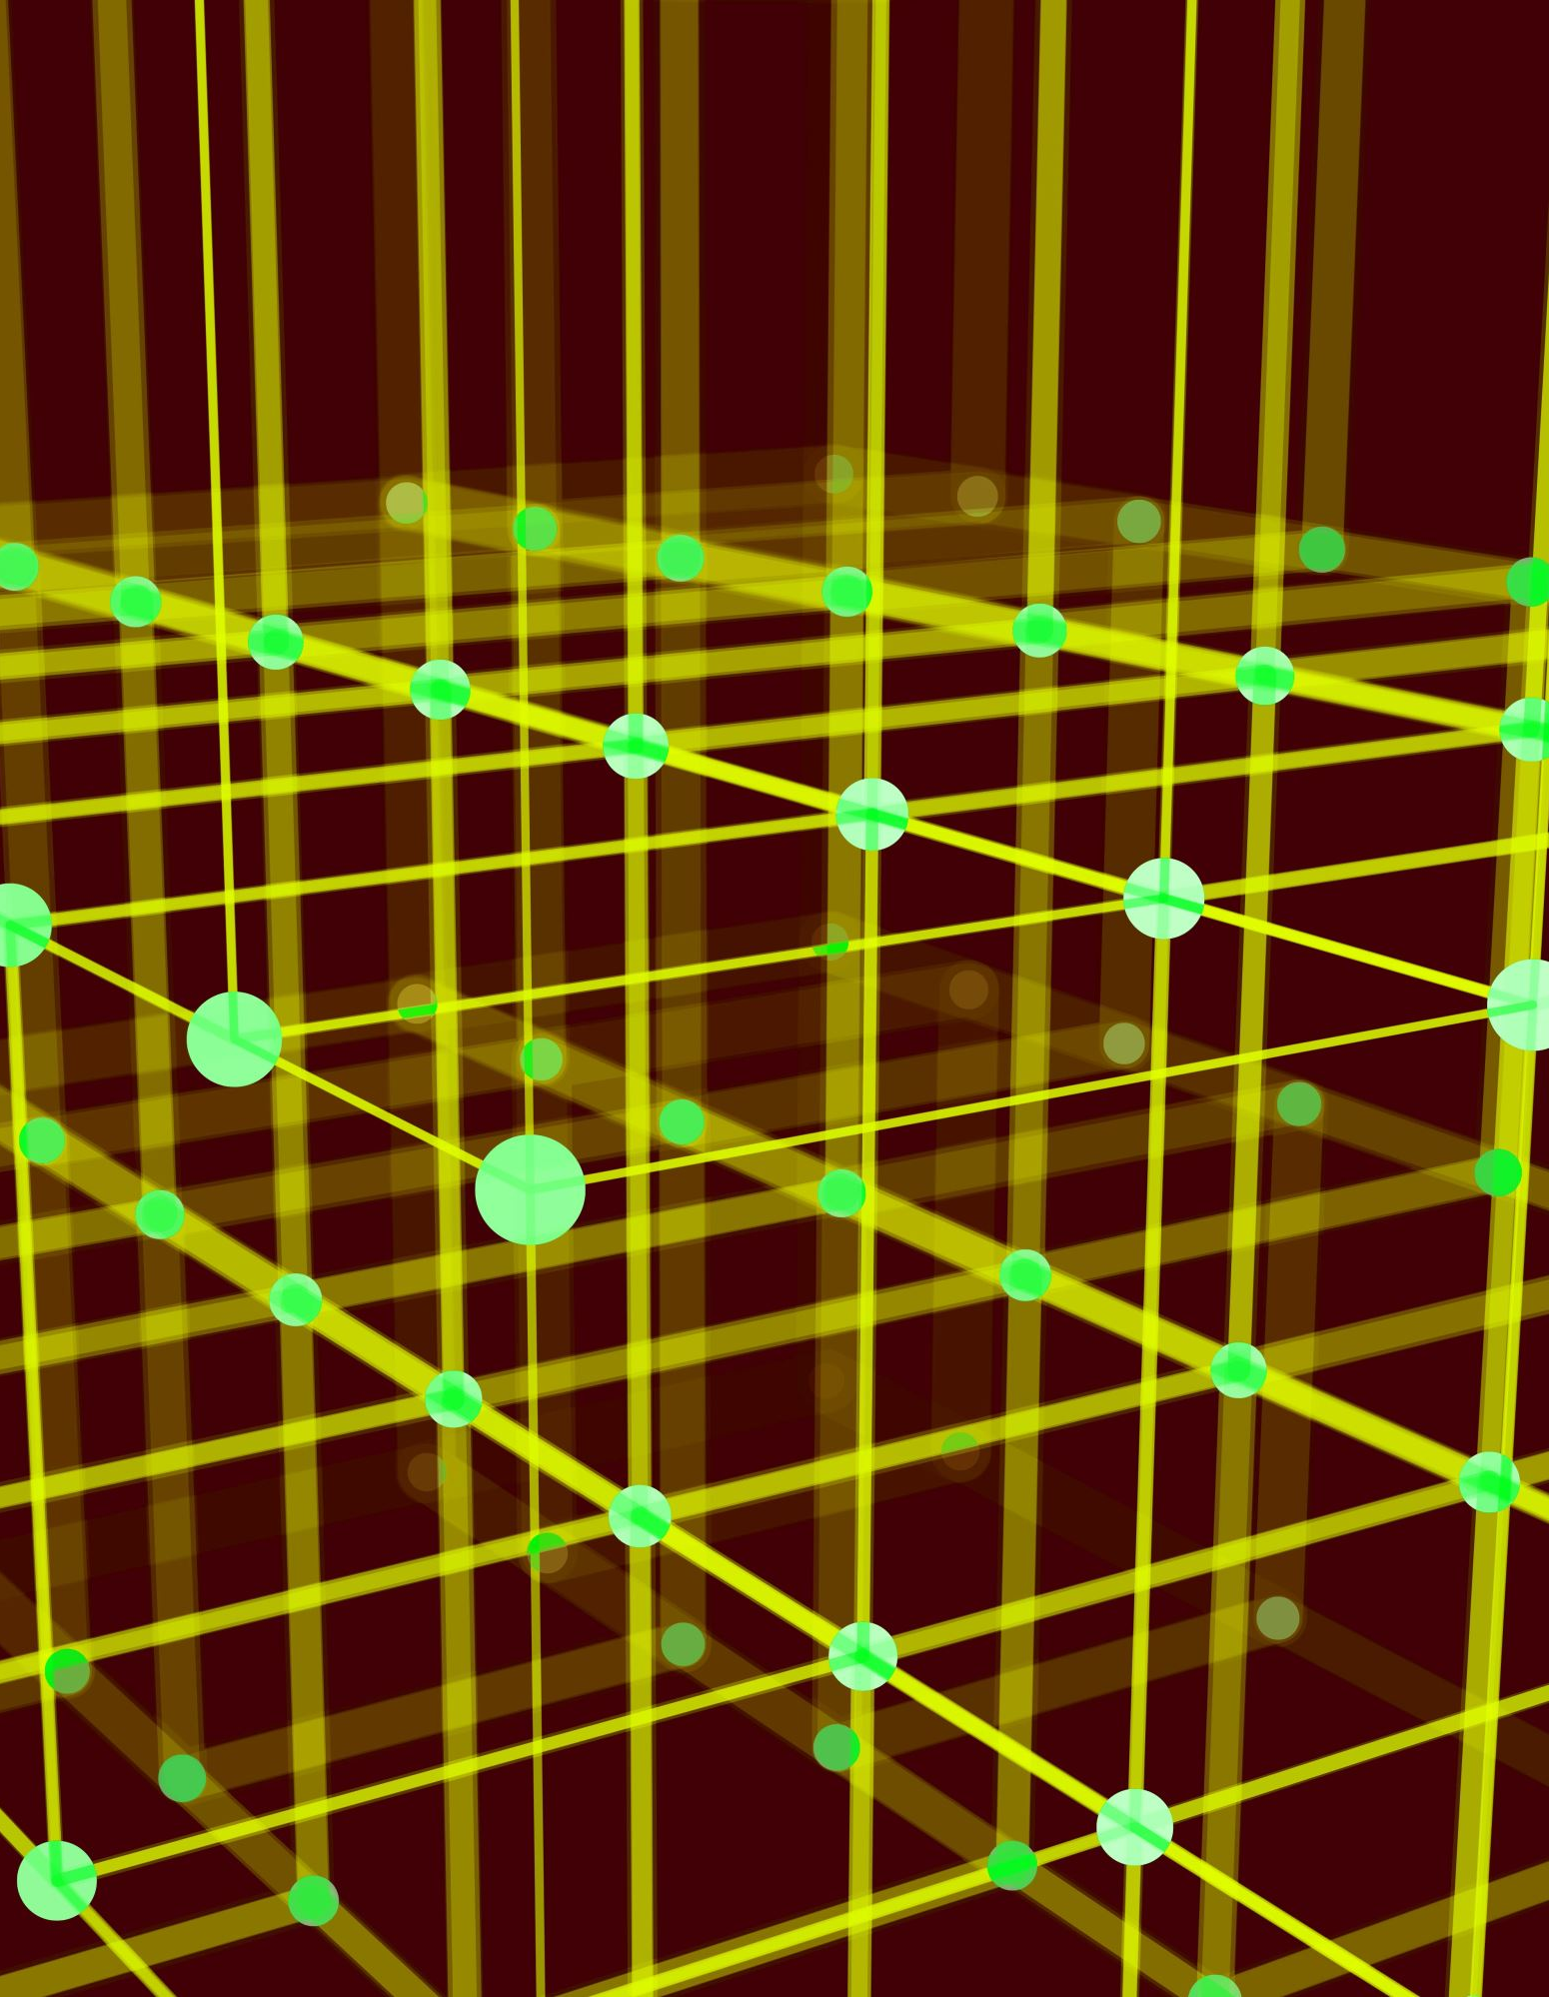
Designing Topologies in GNS3
Topologies to be Designed:
Mesh Topology
Ring Topology
Star Topology
Bus Topology

Slide 9

Mesh Topology
Explanation:
Each device is connected to every other device.
Provides high redundancy and fault tolerance.

Slide 10
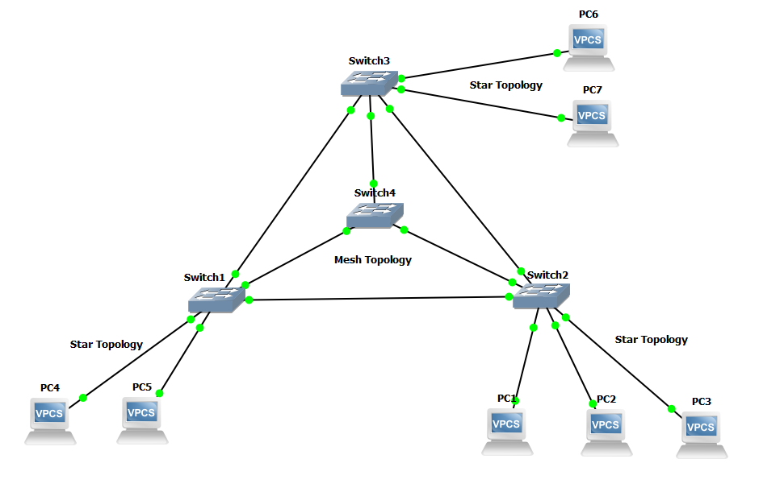
Mesh Topology in GNS3

Slide 11

Ring Topology
Explanation:
Devices are connected in a circular manner.
Each device connected to two other devices.
Equal network access but can be affected by single point failures.

Slide 12
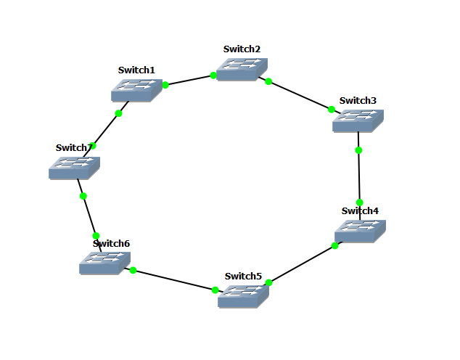
Ring Topology in GNS3

Slide 13

Star Topology
Explanation:
Multiple devices connected to a central switch.
Easy to manage but has a single point of failure at the switch.

Slide 14
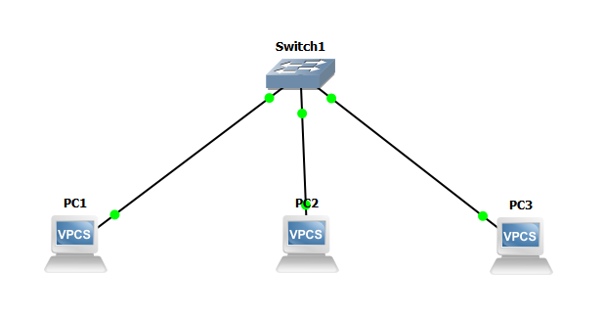
Star Topology in GNS3

Slide 15
Bus Topology
Explanation:
Devices connected along a single communication line.
Simple and cost-effective, but prone to data collisions.

Slide 16
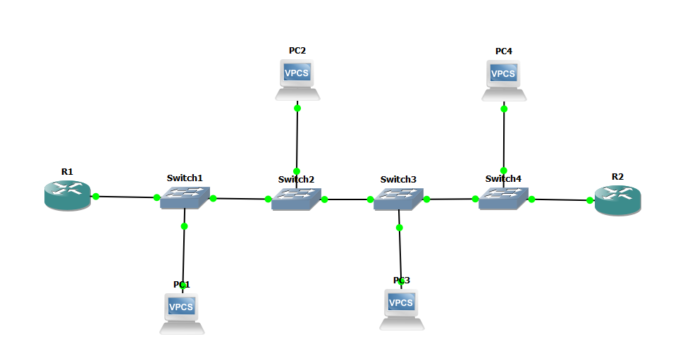
Bus Topology in GNS3

Slide 17
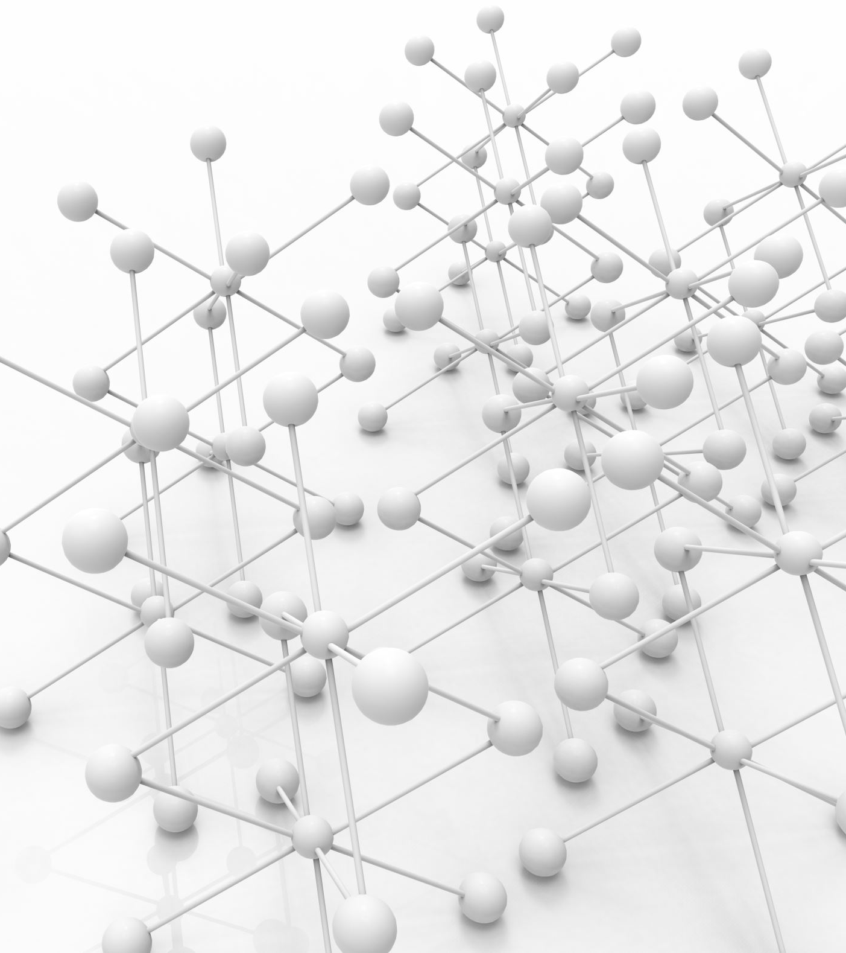
Network Architecture for an Organization
Designed a Complex Network:
Combined multiple topologies to form a comprehensive network.
Included various network devices (routers, switches, PCs).

Slide 18
Network Architecture for an Organization

Slide 19
Network Architecture for an Organization
Network Addressing:
PC1: IP Address - 50.50.50.1, Subnet Mask - 255.255.255.0 (/24)
PC2: IP Address - 50.50.50.2, Subnet Mask - 255.255.255.0 (/24)
PC3: IP Address - 50.50.50.3, Subnet Mask - 255.255.255.0 (/24)

Slide 20
Network Architecture for an Organization
Network Protocols:
Internet Protocol (IP): IPv4, handles addressing and routing of data packets.
Address Resolution Protocol (ARP): ARP matches IP addresses to physical MAC (Media Access Control) addresses.
Internet Control Message Protocol(ICMP): ICMP is used for sending error messages and operational information. Tools like ping use ICMP to check if another computer is reachable on the network.
Transmission Control Protocol (TCP): TCP ensures that data is reliably transmitted between computers.

Slide 21
Network Analysis with Wireshark
Captured and analyzed network packets using Wireshark.

Slide 22
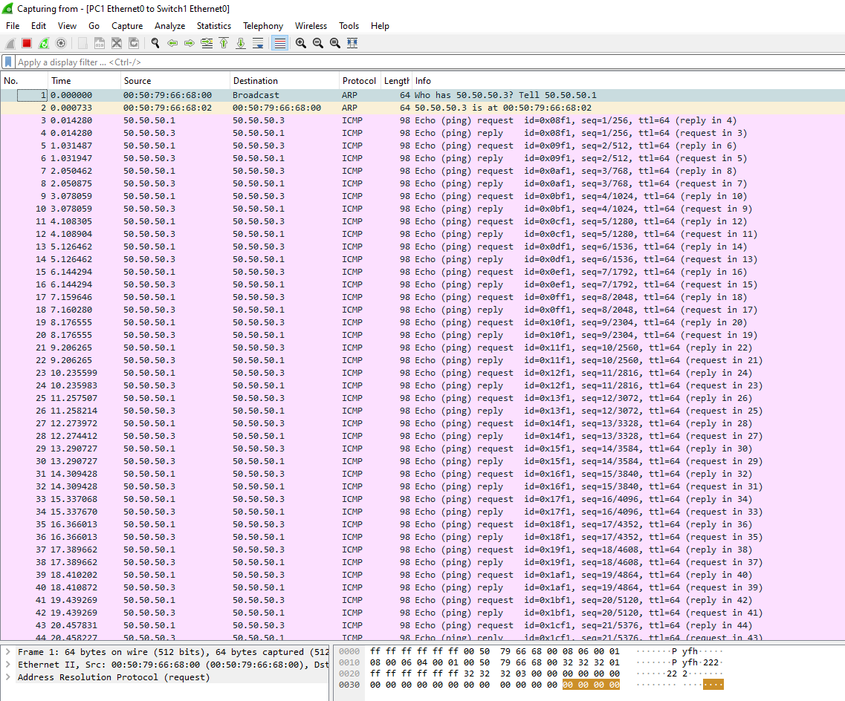
Network Analysis with Wireshark

Slide 23
Evaluation
To evaluate the effectiveness of GNS3 in network simulation, several topologies were implemented and tested.
The topologies included star, mesh, bus, and ring configurations, each chosen for their unique characteristics and usage.
GNS3 effectively simulated these network topologies.

Slide 24

Conclusion
GNS3 Effectiveness:
Successfully implemented star, mesh, bus, and ring topologies.
Learning and Experimentation:
GNS3 Provides a valuable platform for both educational and professional purposes.
Future Directions:
Explore more complex setups and additional GNS3 features.

Slide 25

Thank You

